Slide 1
Online Restaurant Automation
Presented by Shamima Akthar
Roll:13205445

Slide 2
Online Restaurant
Automation
?
Notes:
It is a web application to automate the order system in a restaurant. In most cases in the restaurant we get printed menu to choice food item.
But here we faces some problems such as sometimes the waiter says that this item is not available today. Again manager faces problems to
Set the menu for the next day. Cashier faces some problems in preparing cash memo. To solve these kinds of problem I am proposing system.
Here customers can order food items from a dynamic menu, managers can set menu for the next day dynamically and this system makes easy to
Provide cash memo to the customer.

Slide 3
Objectives
Dynamic food choice
Can order as many as wish
Fast order system.
We are using Tablet Pc to take order from the customers to make it easy to
select the food items
Admin will set the menu previous night, which will be available the next day.

Slide 4
Motivation
To make customer's menu selection easier and dynamic
To give flexibility of setting menu of next day
To make the payment easier

Slide 5
About project
The features are given below:
Admin:
Set manu item everyday for the next day.
Can add,delete , edit food item.(item details)
Customer:
Traverse menu
Order food
Can add or cancel order
(everything will be done by taking table number as customer id)
Notes:
"Online restaurant automation" is a web based application where the ordering system is automated.In my project there are three sections. The sections are admin,customer and receptionist.Admin can add,edit,delete any item.Admin can also set the next day menu.In customer section,there is dynamic
menu for item selection. Customer can add, edit, delete order.The selected item of customer is detected by id of table. In receptionist section, the
receptionist detect the table id,calculate the bill and print the bill.

Slide 6
Receptionist:
Detect the order from table number.
Check any discount.
Print the bill.

Slide 7
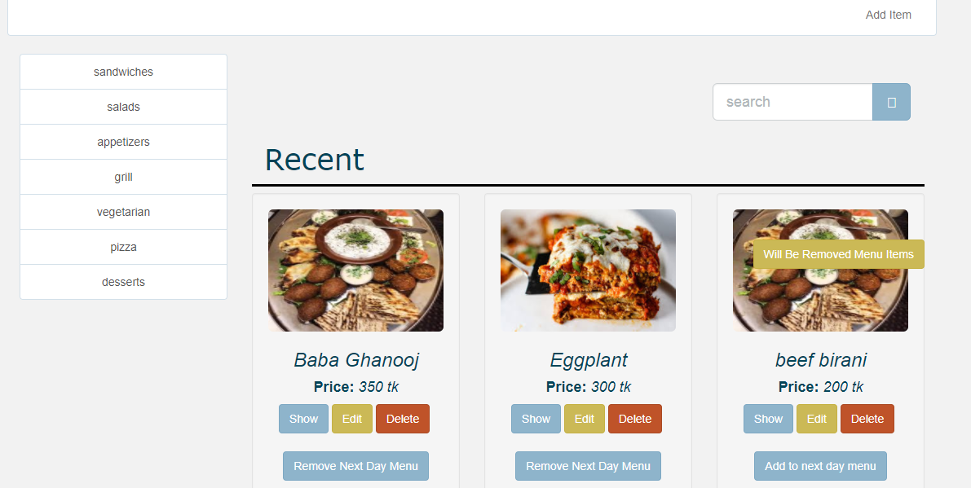
Admin
Notes:
This is admin page. In the left side there are category of items.There are also recent,special,normal items here.

Slide 8
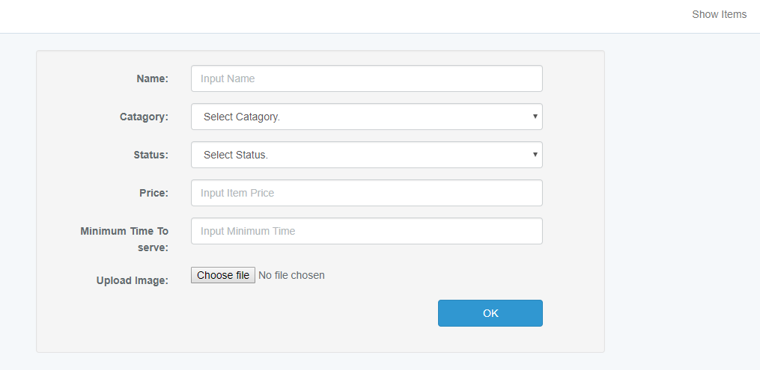
Add item
Notes:
By clicking add item in the navigation admin can add any item.

Slide 9
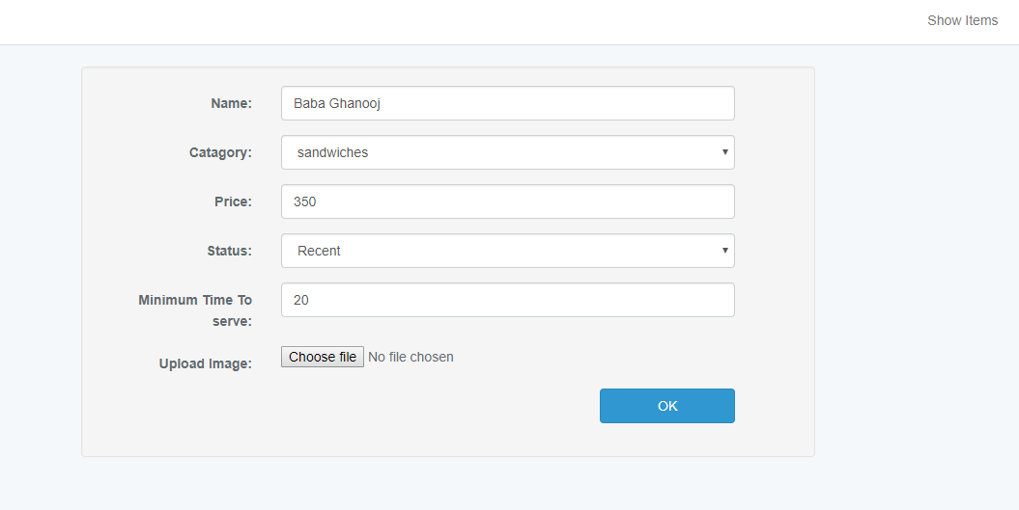
Edit item
Notes:
By clicking edit item admin can edit any existing item.

Slide 10
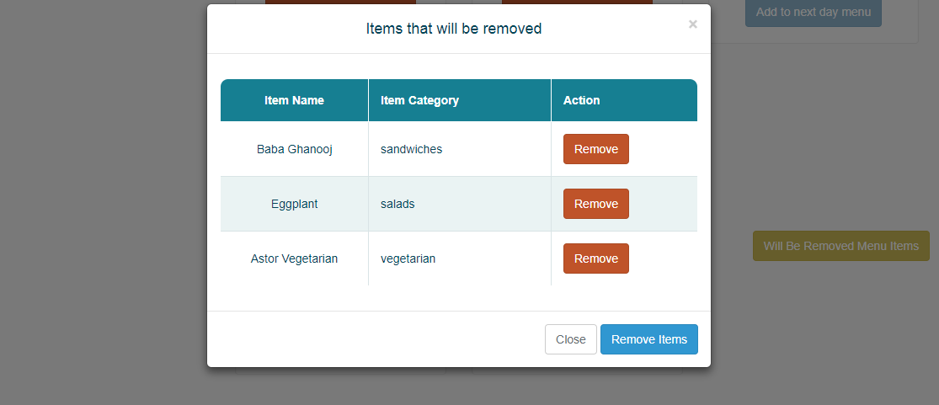
Delete item
Notes:
Admin can select item to remove for the next day by clicking remove next day menu or can add item by clicking add the next day menu.By clicking remove the next day menu and will be removed menu items we will see the following window:

Slide 11
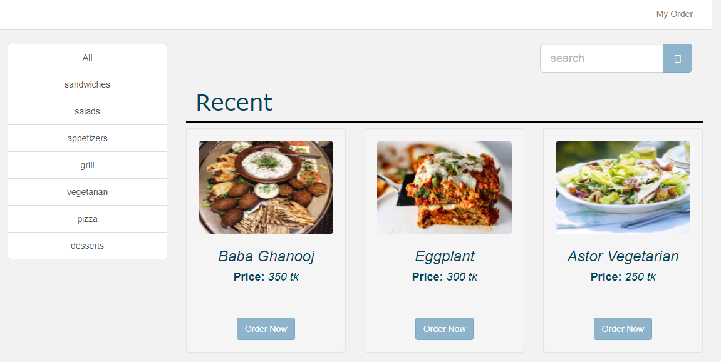
Customer
Notes:
This is customer page.In the left side there are category of all items.customer can order any item.

Slide 12
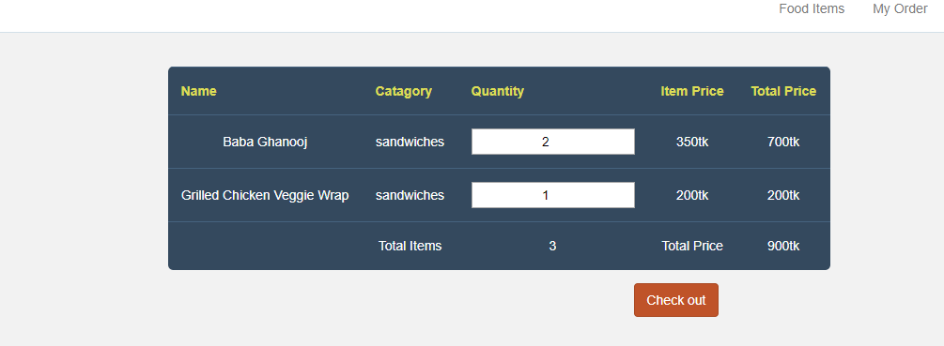
Set menu message
Notes:
By clicking order now customer can see the window that will show the ordered food,category,quantity,price.

Slide 13
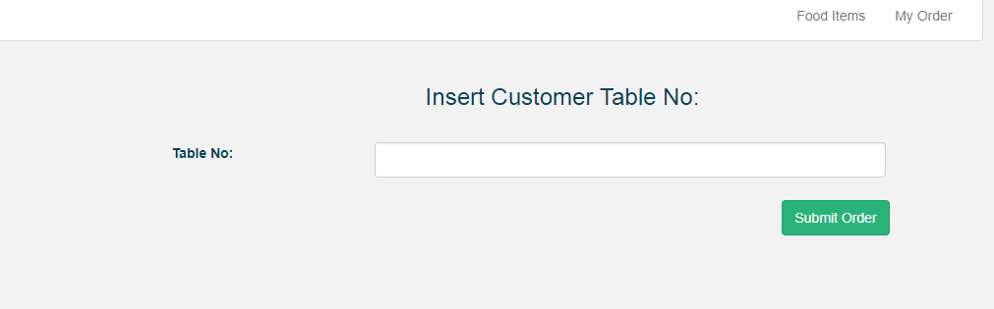
Customer table
Notes:
By clicking check out button customer will see insert the table number.

Slide 14
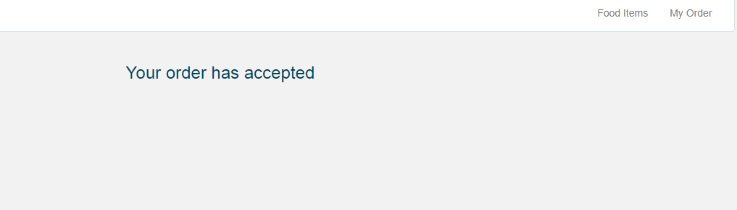
Customer confirm order
Notes:
Customer will enter thei table number and By clicking the submit order button,customer will see the order is accepted.

Slide 15
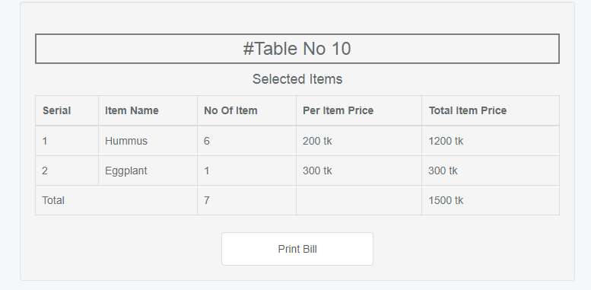
Receiptionist
Notes:
Receptionist can view order and print the bill.

Slide 16
Flow chart - Admin
Start
Add ,delete,edit item
Set menu everyday for the next day
End

Slide 17
Customer
Start
Order food
Can add or cancel order
End

Slide 18
Receptionist
Start
Calculate the bill Print the bill
End

Slide 19


